Slide 1
RAID 환경에서 sync로 인한 overhead 분석
김서진

Slide 2
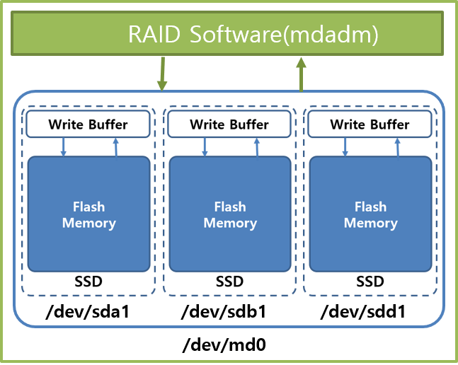
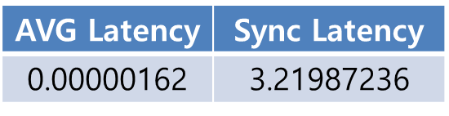
RAID5에서 parity로 인한 sync
Motivation
RAID software(MDADM)에서 만든 parity의 손실을 방지하기 위해서, write buffer에서 flush를 더 자주 내려줄 것이다.
Experiment
Sync로 인한 performance overhead확인
RAID0 vs RAID5 sync count 비교
Parity write 이후 sync 확인
dev | RAID0 | RAID5 | 증가율
md0 | 26 | 102 | 1.47배
sda1 | 84 | 1329 | 7.76배
sdb1 | 43 | 1309 | 7.88배
sdd1 | 49 | 1465 | 7.73배

Slide 3
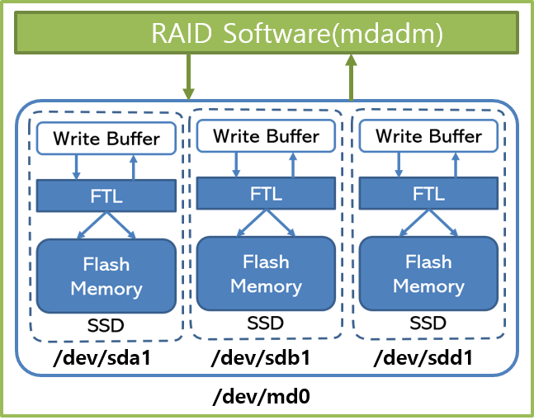
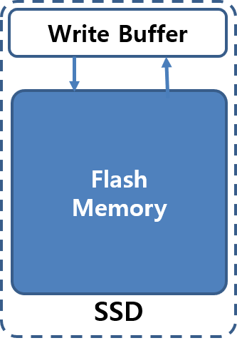
RAID 환경에서 sync로 인한 overhead 분석
Motivation
Software RAID 환경에서 Data Loss(window of vulnerability) 문제 발생
Data Loss 문제를 해결하기 위해서 consistent update problem 발생 (Barrier)
SSD내부에 존재하는 write-buffer에서 flash-memory로 flush하기 위해, 추가적인 sync operation에 대한 performance overhead 발생
Solution (Analysis)
RAID device가 추가될 수록, sync로 인한 overhead 증가
RAID 5에서는 RAID software에서 parity를 생성해서, write 해야 하므로(parity에 대한 consistency를 보장하기 위해), RAID0 에서 보다 sync overhead 증가
Goal
Device가 증가할 수록, RAID5가 RAID0 보다 더, sync operation으로 인한 overhead가 클 것이다.
RAID Software(mdadm)
/dev/sda1
/dev/sdb1
/dev/sdd1
/dev/md0

Slide 4
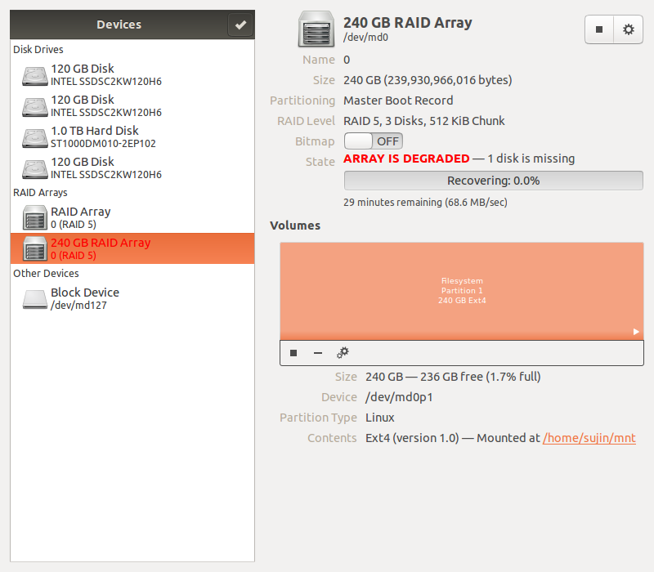
현재 상황
RAID5 구성시, 1 disk가 degraded 되는 문제가 발생함.
Recovery 이후에도 사용가능한 용량이 240GB밖에 되지 않음

Slide 5
Device별로 sync overhead
Motivation
Device 개수가 늘어날수록, Sync 되어야 하는 device 개수가 늘어나고,
Sync로 인한 전체 Latency가 증가하므로 Performance 측면에서 overhea가 있다.

Slide 6
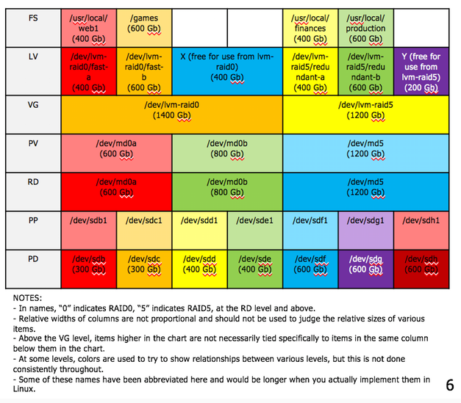
LVM on top of RAID
Filesystem(FS)
/usr/local/lvm0
Logical Volume(LV)
/dev/lvm-raid0/lvm0
Volume Group(VG)
/dev/lvm-raid0
Physical Volume(PV)
/dev/md0
RAID device(RD)(via mdadm if Linux SW RAID)
/dev/md0
Physical Partition(PP)
/dev/sdb1
Physical Device(PD)
/dev/sdb

Slide 7
Background
HW Raid
SW Raid
Hardware RAID and SSD arrays
HW RAID vs SW RAID
SW RAID에서 window of vulnerability 로 인한 consistent update problem
Barrier 관련 research

Slide 8
Hardware RAID
Boosts system performance for backups and restoration, (especially in legacy equipment with limited processing power, by adding DRAM cache memory to the system.) Translates to less strain on the system when writing backups, and less downtime when restoring data.
Adds RAID configuration options that may otherwise be unavailable using just the motherboard—like RAID 5/6, for example, which provides one and two drive failure tolerance.
Protection against data corruption resulting from a loss of power during the backup process. Battery backup units (BBU) or onboard Flash memory in RAID cards provide the extra fail-safes here.
Adds system compatibility with enterprise SAS HDDs, which are designed for 24/7 operation and have extra error correcting features compared to consumer-grade SATA III HDDs.

Slide 9
Software RAID
최신식 multi-core server CPU는 많은 system 제약 없이도 백업 및 복구 작업을 실행할 수 있을 만큼 강력하다. Hardware RAID를 사용함으로써 얻을 수 있는 백업 및 복구 성능 향상이 매우 미미할 때.
Software RAID is used exclusively in large systems (mainframes, Solaris RISC, Itanium, SAN systems) found in enterprise computing.
SMBs using NAS devices for backup and restore purposes will find many software-RAID based options: Netgear ReadyNAS; Synology DiskStation(DS), Buffalo TeraStation, are examples.
Open source인 Software RAID를 사용하는 경우, Flexibility를 얻을 수 있다. Ex. Linux Mdadm
Software RAID 지원가능한 Hypervisors를 사용하는 경우 ex. Hyper-V -> Storage Space 사용

Slide 10
Hardware RAID and SSD arrays
System administrators have reported inconsistent performance for certain hardware RAID setups that use flash storage (SSD) arrays. Older RAID controllers disable the built-in fast caching functionality of the SSD that needed for efficient programming and erasing onto the drive. Most current generation RAID controllers give users the option of re-enabling SSD disk caching to alleviate this.
Having an all-flash storage array set up for RAID 5 provides substantial performance gains compared to a HDD array.

Slide 11
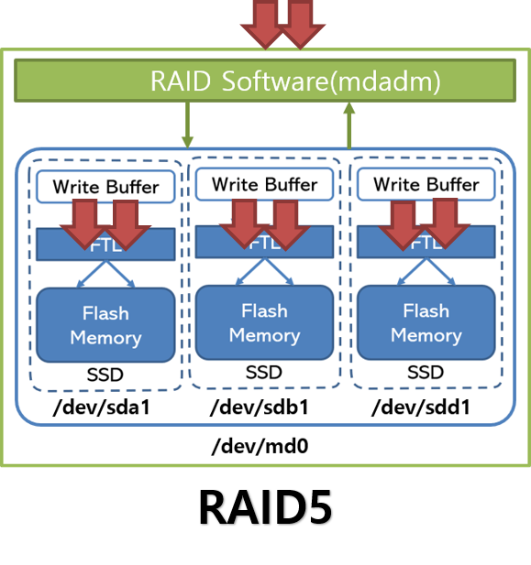
HW RAID SW RAID
The type of RAID best suits data backup needs will vary from system to system. Hardware RAID is more common in Windows Server environments, wherein its advantages are better realized. Software RAID is more prevalent in open source server systems, wherein its flexibility and comparative low cost of entry make it an attractive option. Both options are completely viable; answering the hardware RAID vs Software RAID question depends on assessing the IT infrastructure—the sever hardware and system administrators operating it—to determine what makes the most sense for any organization.

Slide 12
Barrier in ext4
RAID Software(mdadm)
RAID5
/dev/sda1
/dev/sdb1
/dev/sdd1
/dev/md0

Slide 13
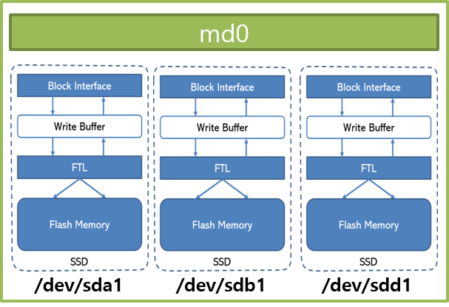
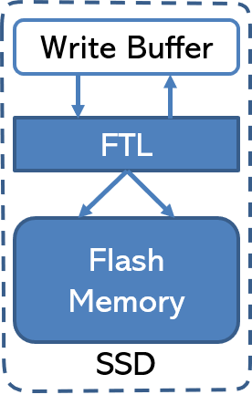
SSD
Write Buffer
Flash
Memory
RAID Software(mdadm)
RAID Software(mdadm)
/dev/sda1
/dev/sdb1
/dev/sdd1
/dev/sda1
/dev/sdb1
/dev/sdd1
/dev/md0
/dev/md0

